Slide 1



The Economic Tango
The Relationship Between Supply & Demand

Slide 2
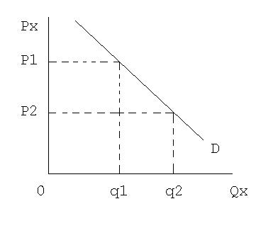
Change in Quantity Demanded
Price Reason Only- Movement Along the Curve
Law of Demand
As price decreases quantity demanded
increases.
As price increases quantity demanded
Decreases.

Slide 3
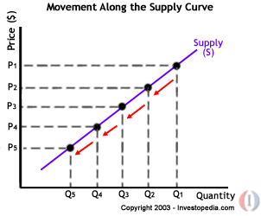
Change in Quantity Supplied
Law of Supply
As price increases quantity
supplied increases.
As price decreases quantity
supplied decreases.

Slide 4
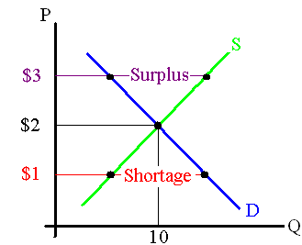
Surplus and Shortage

Slide 5

“Its not about the money”

Slide 6
Determinants (Non- Price) Factors)
Demand
Tastes and Preferences
Change in Income
Price of Substitutes
Price of Compliments
Future Price Expectations
Change in Market Size
Supply
Cost of Inputs
Changes in taxes and subsidies
Future Price Expectations
Number of Competitors
Change in Technology and Productivity

Slide 7
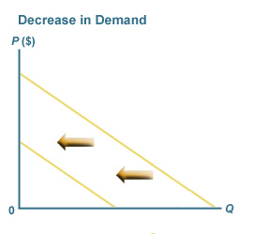
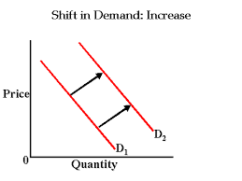
Change in Demand

Slide 8

Tastes and Preferences
Notes:
Sabbatha
A consumers preference for a product will cause the demand of that product to increase (which will cause the demand curve to shift to the right). Preferences rely on satisfaction and enjoyment. A prime example of a consumers taste and preference is the clothing market. Trends help influence what consumers want and desire, which obviously affects the market.

Slide 9



Income
Real-world example: increase in federal minimum wage
Notes:
Adin
It’s fairly intuitive that when people make more money, they are more likely to buy more goods. This increase in willingness to spend money results in an increase in demand for most goods or services. This can be represented by a rightward shift in the respective demand curves for these products. For example, if a consumer received a bonus stipend at their work, they might be more likely to go and buy a new pair of Italian sunglasses.
However, for some lower quality goods, demand may decrease when the income of consumers increases. Consumers, upon earning more money, will choose to buy other goods of a higher quality. These goods that consumers are less likely to buy are called “inferior goods”. And example of an inferior good would be fast food, because consumers, upon earning more money, would likely be able to spend more of their money on higher quality food.

Slide 10




Prices of Related Goods
Substitutes
Complements
Notes:
John: In a Supply and Demand model, the whole demand curve shifts when the prices of related items change. This is different from when an object’s own price changes and its corresponding demand settles at a new point along the demand curve. For example, here in New York, when there is an abundance of locally grown apples in the fall, the price of apples may go down, making them a higher-demanded item than normal. As a result of people spending more of their money on apples, there is an inherent drop in demand for bananas or other exotic fruits, even if their price remains the same. Goods where an increase in demand of one leads to a decrease in demand of the other are known as substitutes. In another example, say the pdemand for flowers decreases in the winter. In this case, the demand for flower pots will also be lower, even if the price for a flower pot stays the same. Goods where an increase in demand of one leads to an increase in demand of the other (or vice versa) are known as complements.

Slide 11

Number of Consumers
Notes:
John: Simply put, the more people that exist to demand an item, the greater the demand on that item will be. This is independent of any changes in price that may occur. As population increases, demand also increases. http://electrical-engineering-portal.com/wp-content/uploads/figure1-global-trends-in-population-energy-demand-and-water-use.jpg

Slide 12

Expectations
Real world example
Notes:
One will wait for the next big thing. This means that the consumers are decreasing the current demand for a product because of what they expect to happen in the future. This also means that the demand curve will shift to the left because the demand for the current product decreases.

Slide 13
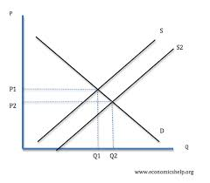
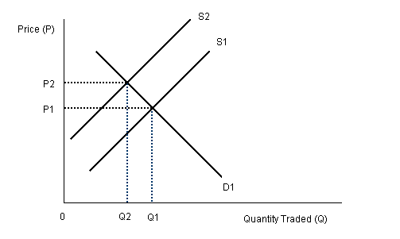
Change in Supply
Decrease in Supply Increase in Supply

Slide 14


Changes in Supply

Slide 15
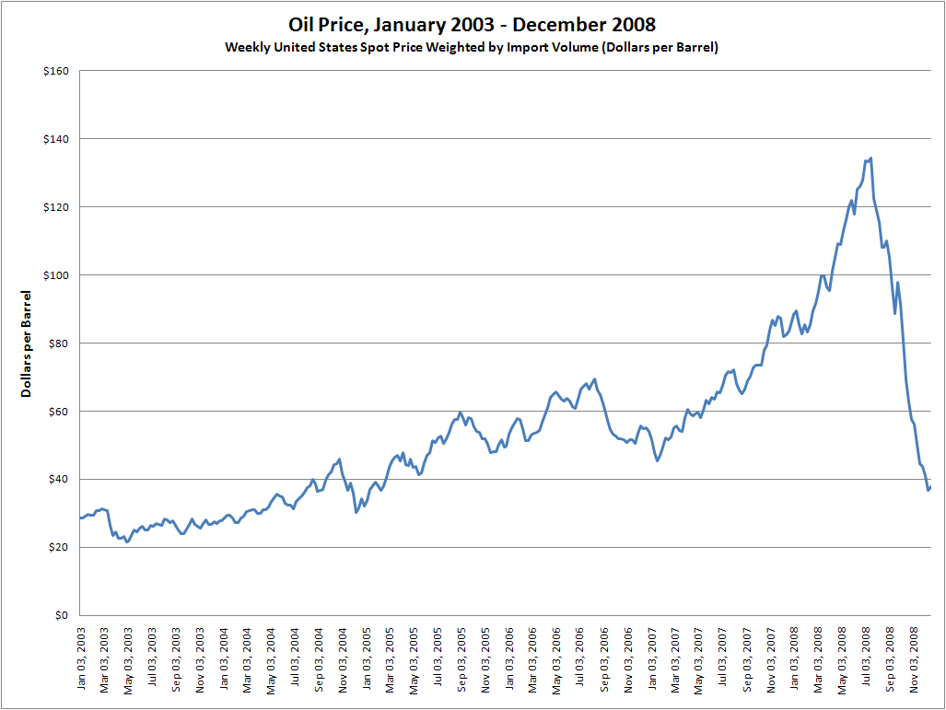

Cost of Inputs

Slide 16

Change in Number of Competitors

Slide 17
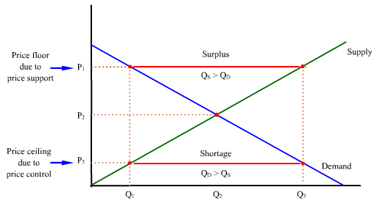
Price Floors and Ceilings

